Slide 1
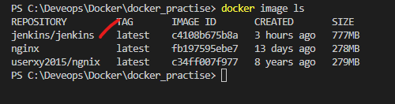
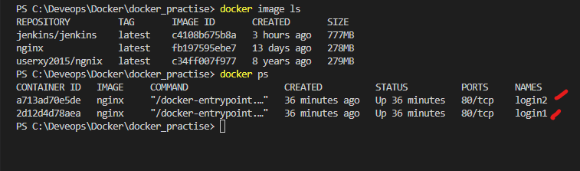
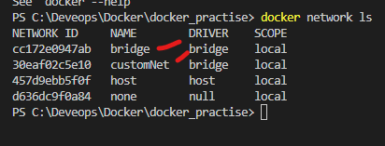
Ping command installation in login 1
Apt update
Apt install –y iputils –ping
Ping ( Ip address of other container )
Commands used
docker exec -it login1 /bin/bash
docker network connect customNet login2
docker run -d --name=login2 --network=bridge nginx
docker run -d --name=login1 --network=customNet nginx
docker pull nginx

Slide 2
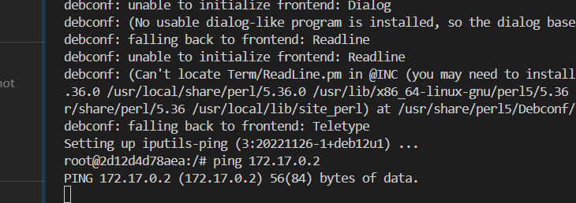
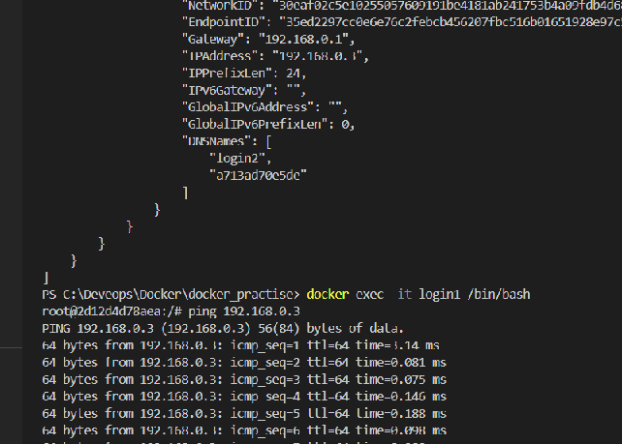
Networking in docker

